Slide 1
Multiple Cars Tracking Basing on Kalman Filter
ECE 251B –Digital Signal Processing Ⅱ
Team #13
Pengluo Wang; Kaiyu Zhang;
Shihao Luo

Slide 2
Contents
01
02
03
04
Problem
Data
Solutions
Results

Slide 3
Problem
Background
The automatic driving is one of the most important technical achievement, which still needs more promotion.
Implement a set of algorithm to combine car detection and tracking together, to provide convenience for car driving.
What we did
Use different methods implement the car detecting and tracking, and add boxes marking the multiple cars in the video.
We choose Tensorflow Object Detection API for car detection.
After getting the location information of detected cars, we make prediction using Kalman filter, and combine the prediction & measurement values as the real tracking value, to finish whole algorithm.

Slide 4
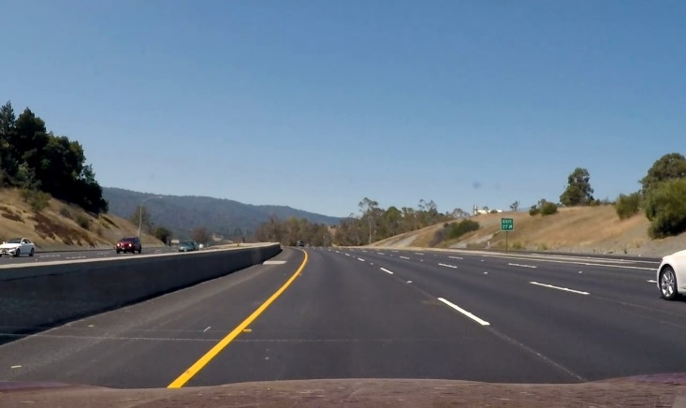
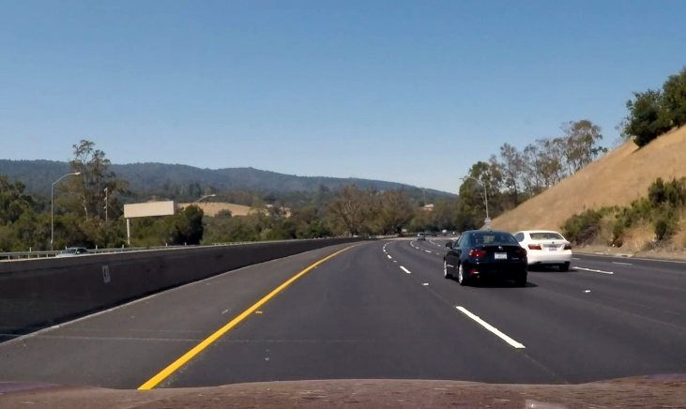
Dataset
Video data
The data we use is a set of video taken by the dashcam in front of our car, which is real and reliable.
The data was taken in our daily life, including different situations: no cars, one car, more than one cars in the visual area.
The cars in the video have several typical behaviors including intersection and overtaking.
(a)
(b)
(c)

Slide 5
Method Introduction – Detection
Tensorflow object detection API
An open source framework built on top of TensorFlow that makes it easy to construct, train and deploy object detection models.
To use this build-in model, we applies SSD with MobileNet, a Single-Shot-Detection with MobileNet architecture trained on COCO dataset.
Single-Shot-Detection (SSD)
SSD algorithm is an object detection algorithm that directly predicts the coordinates and categories of the objection with bounding box.
SSD is much faster than those traditional detection models without losing the accuracy, by adding several separate prediction filters.
SSD advantages
High Speed
High Accuracy
Can be applied with low resolution and video data
Notes:
SSD model is based on a feed-forward convolutional network that produces a fixed-size collection of bounding boxes and scores for the presence of object class instances in those boxes, followed by a non-maximum suppression step to produce the final detections.

Slide 6
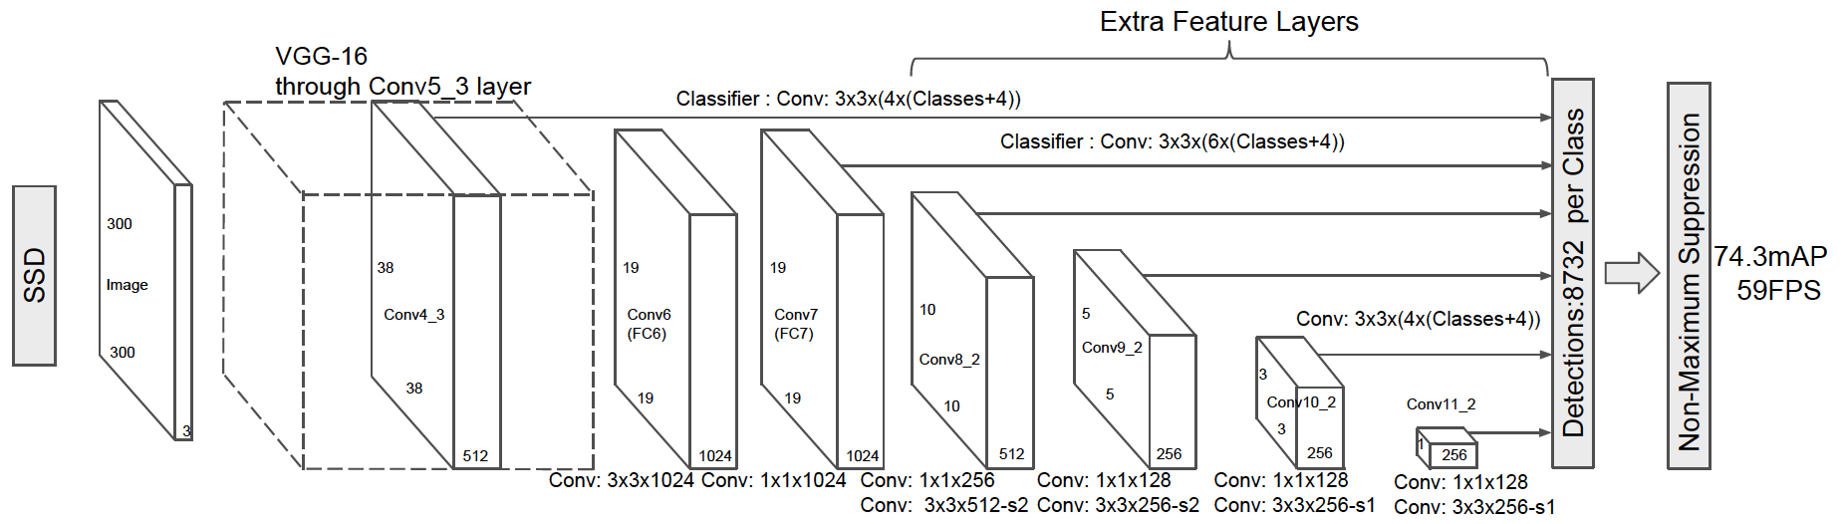
Method Introduction – Detection
SSD – basic frames
Using a small convolutional filter to predict object categories and offsets in bounding box locations.
Using separate predictors (filters) for different aspect ratio detections.
Applying these filters to multiple feature maps from the later stages of a network in order to perform detection at multiple scales.
Train the data with ground truth boxes, and the obtained model can be used for detection.
Notes:
SSD model is based on a feed-forward convolutional network that produces a fixed-size collection of bounding boxes and scores for the presence of object class instances in those boxes, followed by a non-maximum suppression step to produce the final detections.

Slide 7
Method Introduction – Detection
SSD – outcome
This model has been trained with COCO dataset, which can detect the following objects related to transportation:
Label | Objection
1 | Person
2 | Bicycle
3 | Car
4 | Motorcycle
5 | Bus
6 | Train
7 | Traffic Light
8 | Stop Sign

Slide 8
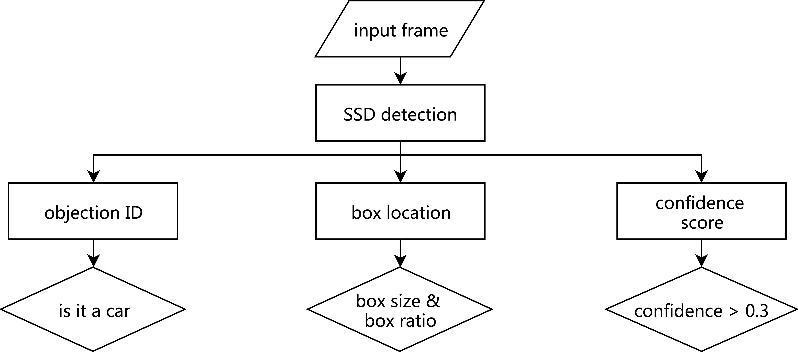
Method Introduction – Detection
Flow chart
Notes:
SSD model is based on a feed-forward convolutional network that produces a fixed-size collection of bounding boxes and scores for the presence of object class instances in those boxes, followed by a non-maximum suppression step to produce the final detections.

Slide 9
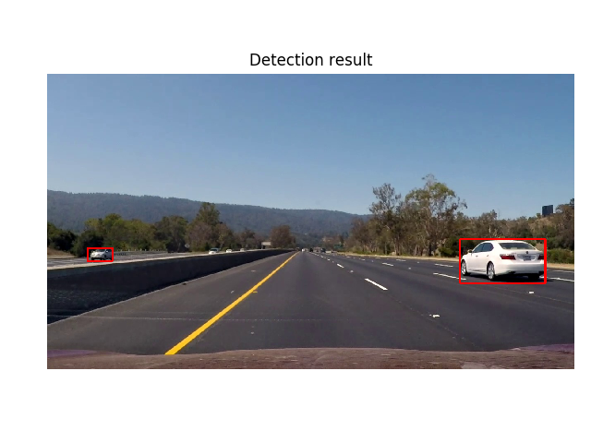
Method Introduction – Detection
SSD – outcome
Using a test image, we have the following outcome:

Slide 10
Method Introduction – Tracking
Kalman filter
An adaptive filter, with following important benefit features:
Predict of object's future location;
Correction of the prediction based on new measurements;
Reduction of noise introduced by inaccurate detections;
Facilitating the process of association of multiple objects to their tracks.
Update process
Prediction: uses previous states to predict the current state.
Correction: uses the current measurement, such as detection bounding box location, to correct the state.

Slide 11
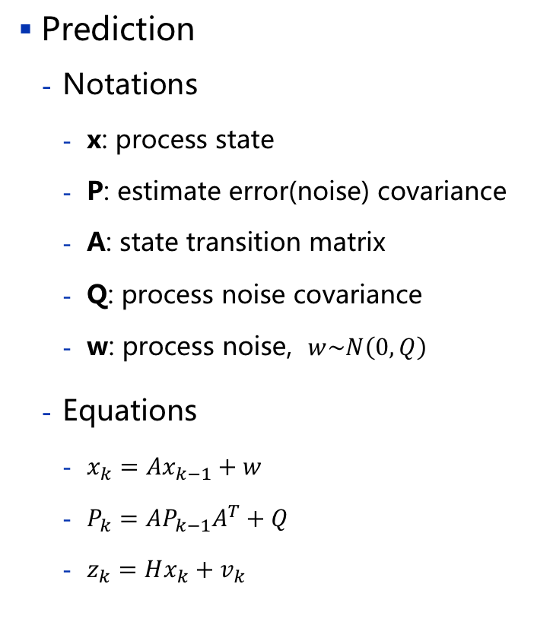
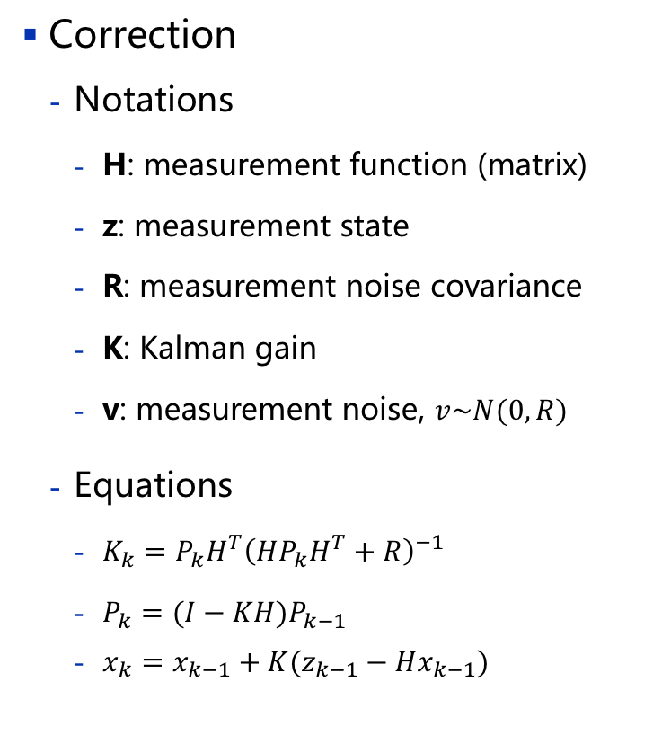
Method Introduction – Tracking
Prediction
Notations
x: process state
P: estimate error(noise) covariance
A: state transition matrix
Q: process noise covariance
w: process noise, $w\sim N\left(0,Q\right)$
Equations
$x_{k}=Ax_{k−1}+w$
$P_{k}=AP_{k−1}A^{T}+Q$
$z_{k}=Hx_{k}+v_{k}$
Correction
Notations
H: measurement function (matrix)
z: measurement state
R: measurement noise covariance
K: Kalman gain
v: measurement noise, $v\sim N(0,R)$
Equations
$K_{k}=P_{k}H^{T}{\left(HP_{k}H^{T}+R\right)}^{−1}$
$P_{k}=(I−KH)P_{k−1}$
$x_{k}=x_{k−1}+K(z_{k−1}−Hx_{k−1})$

Slide 12
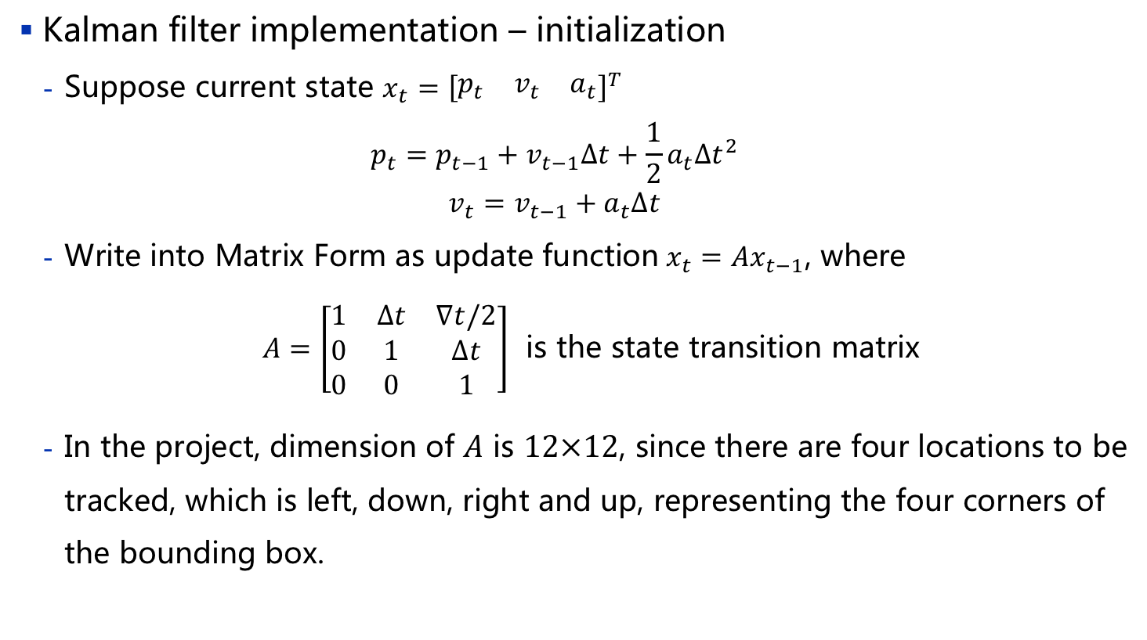
Method Introduction – Tracking
Kalman filter implementation – initialization
Suppose current state $x_{t}={\left[\begin{matrix}p_{t} & v_{t} & a_{t}\end{matrix}\right]}^{T}$
$$\begin{aligned}p_{t}=p_{t−1}+v_{t−1}∆t+\frac{1}{2}a_{t}{∆t}^{2} \\ v_{t}=v_{t−1}+a_{t}∆t\end{aligned}$$
Write into Matrix Form as update function$x_{t}=Ax_{t−1}$, where
$A=\left[\begin{matrix}1 & ∆t & ∇t/2 \\ 0 & 1 & ∆t \\ 0 & 0 & 1\end{matrix}\right]$ is the state transition matrix
In the project, dimension of $A$ is $12×12$, since there are four locations to be tracked, which is left, down, right and up, representing the four corners of the bounding box.

Slide 13
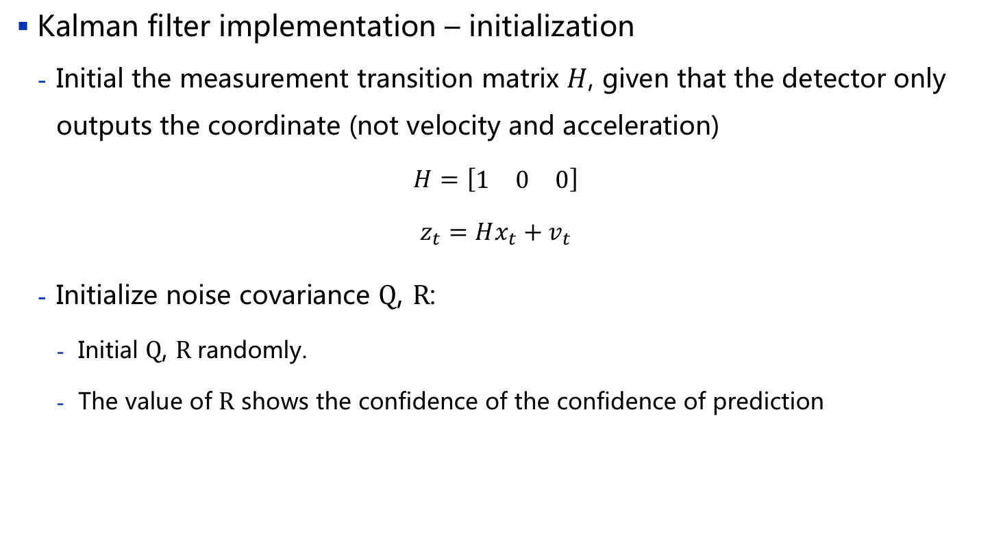
Method Introduction – Tracking
Kalman filter implementation – initialization
Initial the measurement transition matrix $H$, given that the detector only outputs the coordinate (not velocity and acceleration)
$$H=\left[\begin{matrix}1 & 0 & 0\end{matrix}\right]$$
$$z_{t}=Hx_{t}+v_{t}$$
Initialize noise covariance $Q$, $R$:
Initial $Q$, $R$randomly.
The value of $R$ shows the confidence of the confidence of prediction
Notes:
A low R_ratio indicates a more reliable measurement.

Slide 14


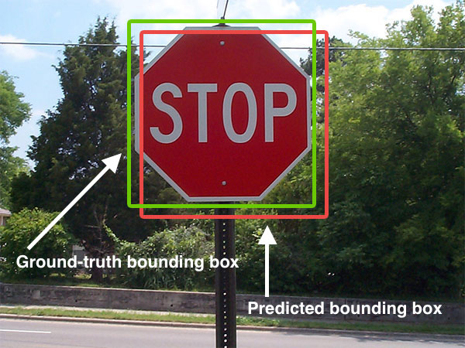

Intersection-over-Union（IoU）
IoU
A parameter shows the accuracy of detection and prediction.
Can be understood as the accuracy rate for each image
For example:
$$\text{IoU}=\frac{\text{DetectionResults}∩\text{TrackingResults} }{\text{DetectionResults}∪\text{TrackingResults} }$$
Notes:
SSD model is based on a feed-forward convolutional network that produces a fixed-size collection of bounding boxes and scores for the presence of object class instances in those boxes, followed by a non-maximum suppression step to produce the final detections.

Slide 15
Detection-to-Tracker Assignment
Linear-Assignment
One of the fundamental combinatorial optimization in order to find a maximum weight matching (or minimum weight perfect matching) in a weighted bipartite graph.
Implemented by package sklearn in Python.
Produce the max matching between detection and tracking box in our project. The results are stored in list matched, unmatched_detections, and unmatched_trackers.
 | D₁ | D₂ | D₃ | D₄
T₁ | 0 | 0 | 1 | 0
T₂ | 1 | 0 | 0 | 0
T₃ | 0 | 0 | 0 | 0
IoU matrix
Notes:
SSD model is based on a feed-forward convolutional network that produces a fixed-size collection of bounding boxes and scores for the presence of object class instances in those boxes, followed by a non-maximum suppression step to produce the final detections.

Slide 16
Pipeline
Sequential processing
Process each frame of the input video, implemented by package MoviePy.
Deals with matched, unmatched_detections, and unmatched_trackers ob-tained from linear assignment of the IoU matrix for each frame.
False alarm & missed detection
Introduce two important parameters, min_hits and max_losses: min_hits stands for the minimum number of consecutive matches to establish a tracker; max_loss stands for the maximum number of consecutive losses to delete a current track.
Introduce a variable to discriminate false alarm and real target, a tracker is called good tracker if it has reached min_hits.
Notes:
SSD model is based on a feed-forward convolutional network that produces a fixed-size collection of bounding boxes and scores for the presence of object class instances in those boxes, followed by a non-maximum suppression step to produce the final detections.

Slide 17
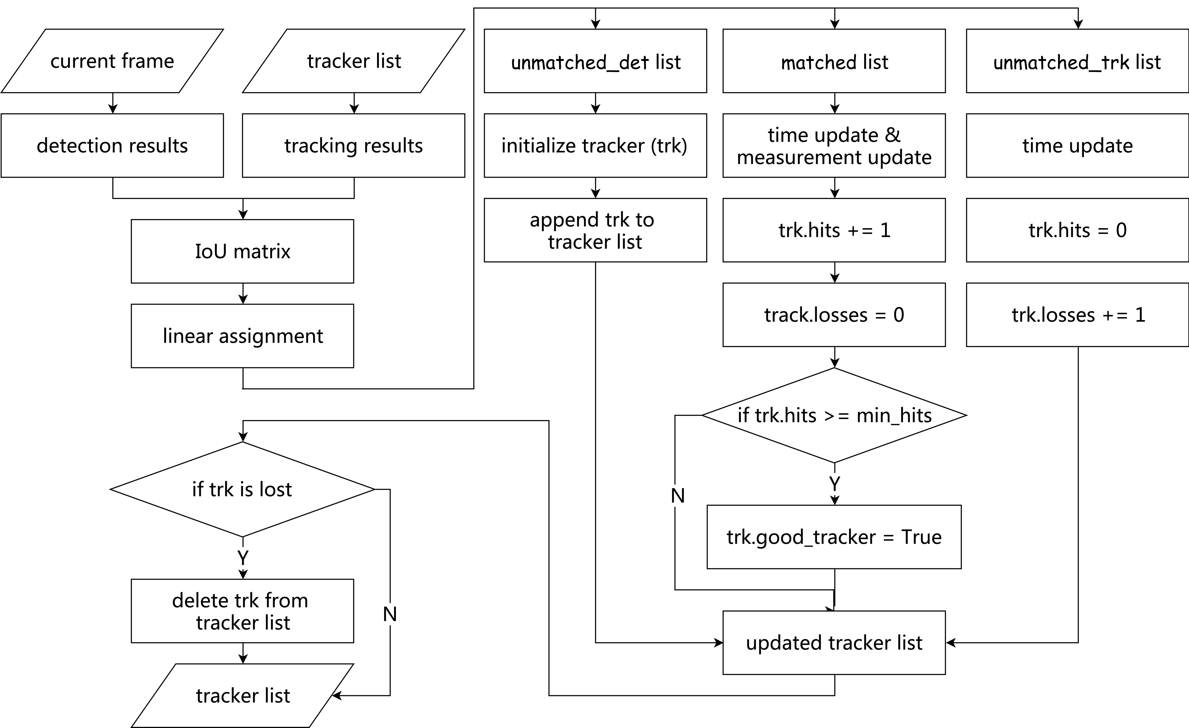
Pipeline Diagram

Slide 18
Results – Frame

Slide 19
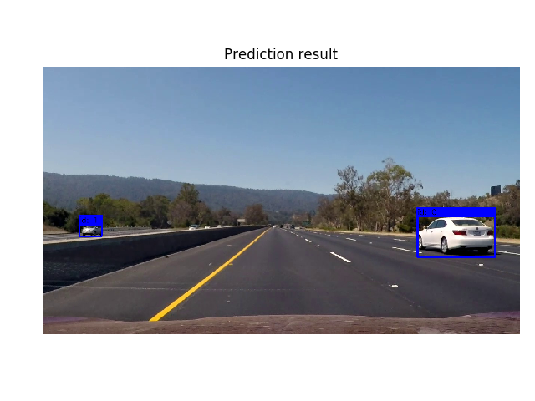
Results – Frame

Slide 20
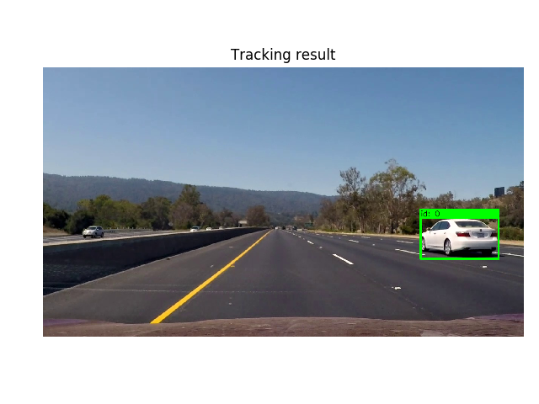
Results – Frame

Slide 21
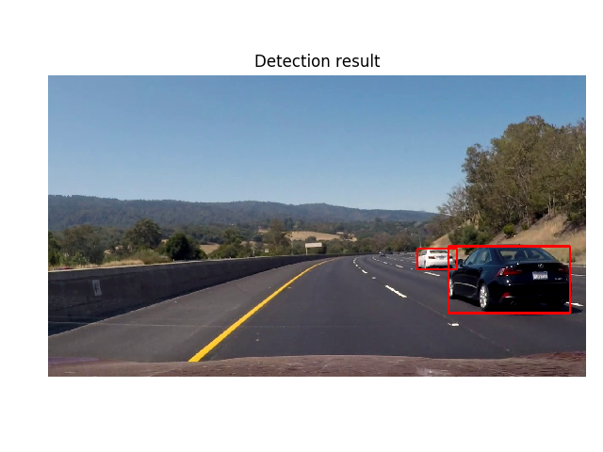
Results – Frame

Slide 22
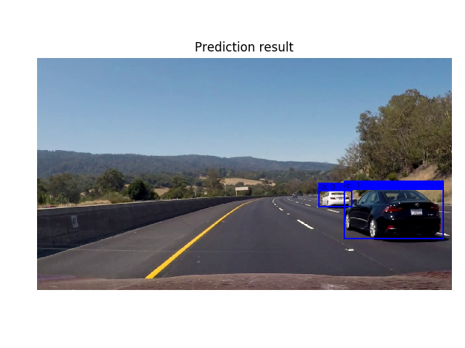
Results – Frame

Slide 23
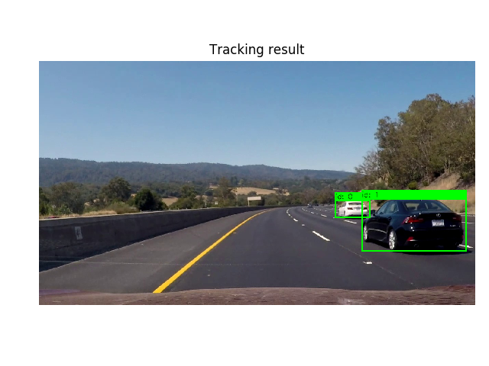
Results – Frame

Slide 24

Results – Frame

Slide 25

Results – Frame

Slide 26
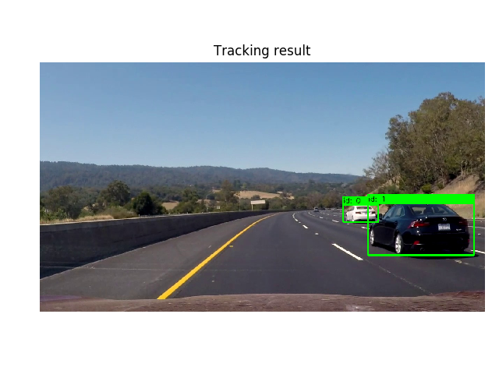
Results – Frame

Slide 27
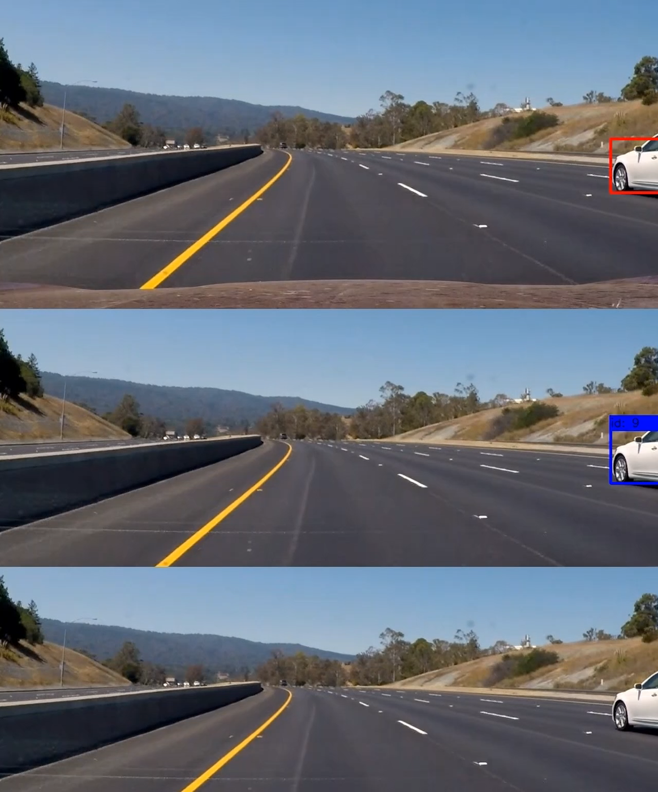
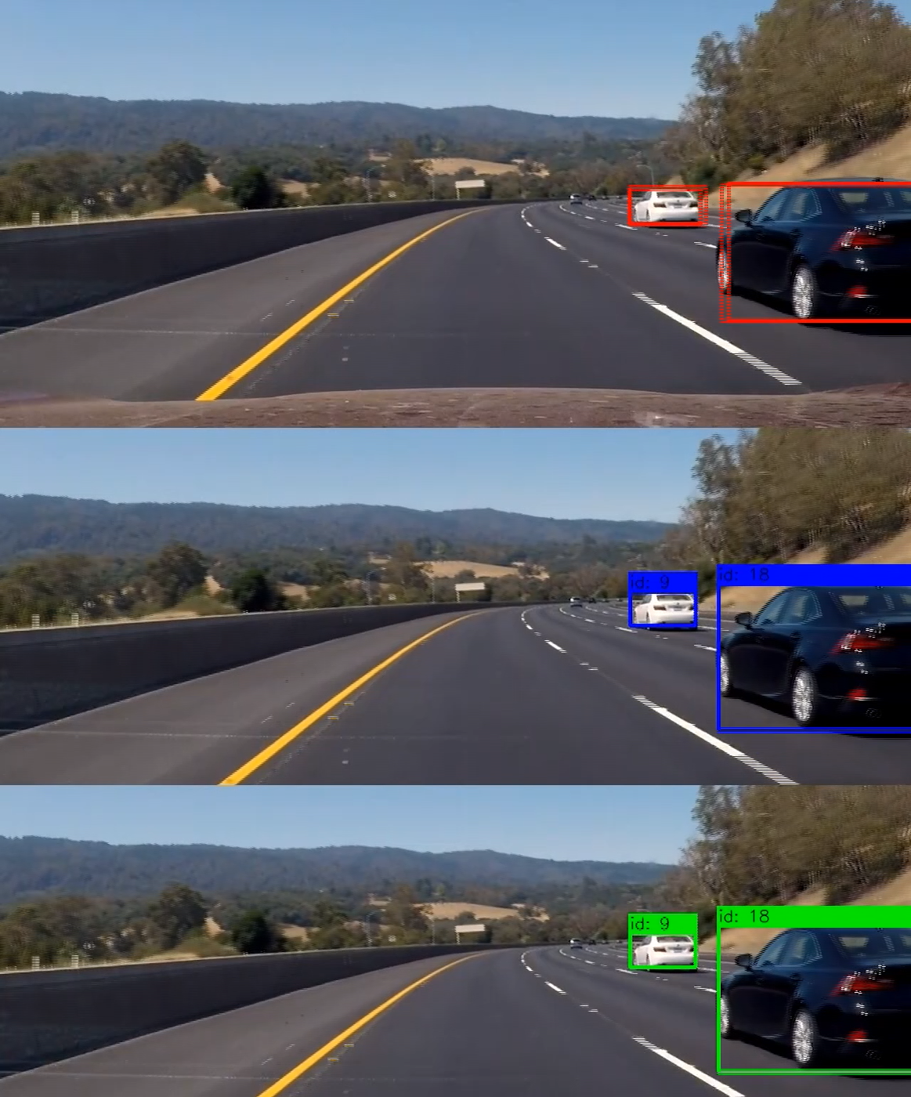
Results – Video

Slide 28
Reference
[1]. Greg Welch, and Gary Bishop, An Introduction to the Kalman Filter, [University of North Carolina at Chapel Hill Chapel Hill], NC 27599-3175, July 24,2016
[2]. Wei Liu, Dragomir Anguelov, Dumitru Erhan, and Christian Szegedy, SSD: Single Shot MultiBox Detector, [cv.CS], Dec 29, 2016
[3]. Jonathan Huang, Vivek Rathod, Chen Sun, et al, Speed/accuracy trade-offs for modern convolutional object detectors, [cv.CS], Nov 30, 2016

Slide 29
Thank You!
Q & A

